Slide 1

STOCK MARKET PREDICTION
TEAM - 5

Slide 2

Team Members
Jyoti Pal
Pranav Nawle
Anubhav Patel
Sreenivas Kunchum
Rituja Tayade
Adarsh kumar Singh

Slide 3
OBJECTIVE
As the company and business are highly affected by the stock market, our model will help analyze the pattern of purchasing and selling the stock for an investor to make a decision and also try to understand the expenses and profit by analysing all factors.

Slide 4
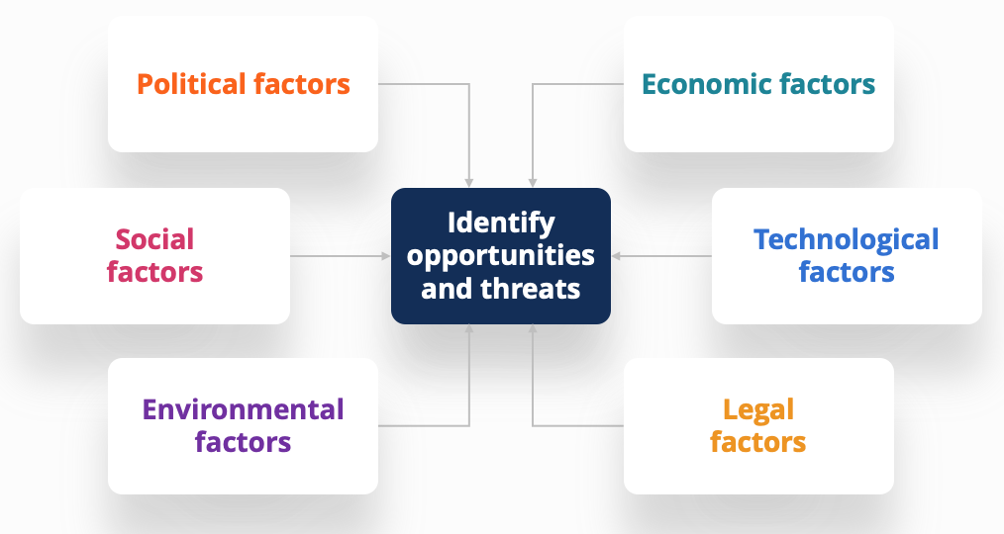
FACTORS AFFECT STOCK MARKET

Slide 5
Project Architecture / Project Flow
Data Collection
Exploratory Data Analysis (EDA) and Visualization
Model Building
Evaluate & Compare Performance
Deployment

Slide 6
DATA COLLECTION

Slide 7
DATA SET
Downloaded the stock market data set from the yfinance website.
Dataset consists of 9th Nov 2015 to 4th Nov 2022 (7 years ) of daily stock market prediction data.

Slide 8
Web Scraping stock data was scraped from yfinance.
Challenges faced:
Data from the original website (yfinance) is not allowed to be scraped however to demonstrate web scraping using beautiful soup we scraped the data from GitHub So finally we go with this data to prediction .

Slide 9
Exploratory Data Analysis (EDA) And Visualization

Slide 10
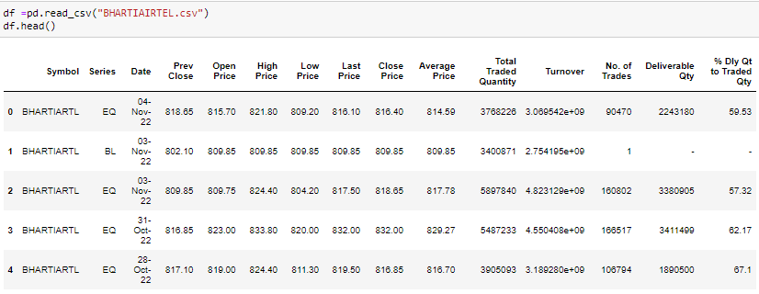

Import Data
Exploratory Data Analysis(EDA)
Data Analysis and Performing necessary changes

Slide 11
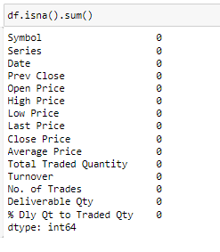
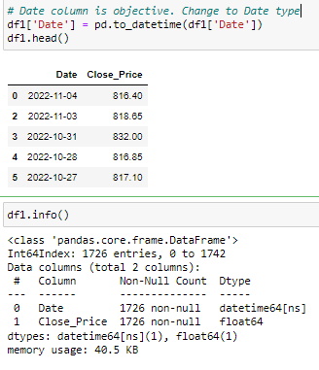
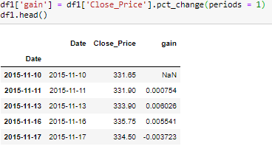
The Data set contains 3276 Rows and 10 Columns
There is no null values in the data set
Date column is objective Change to Date type
Add gain column to use in predictions later

Slide 12
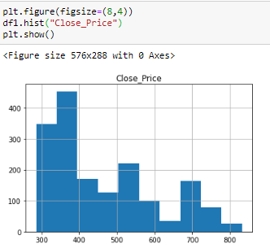
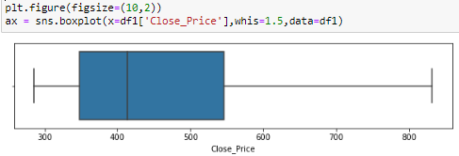
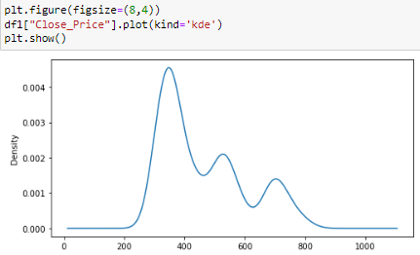
Visualization of data distribution
Outlier detection
Distribution of data is right skewed
There is no outlier in the data set
Histogram
Plot KDE

Slide 13
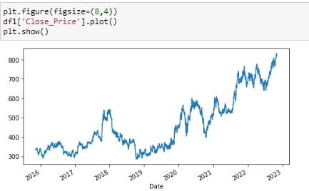
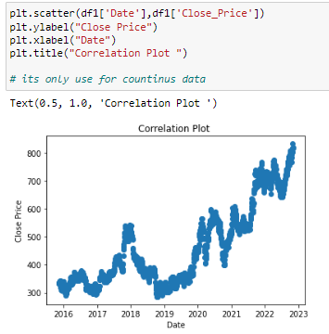
Final Conclusion
The trend is upward or positive. Seasonality can be observed slightly
Correlation between variables
Have a significate relationship to build a good forecasting model

Slide 14
Model Building

Slide 15
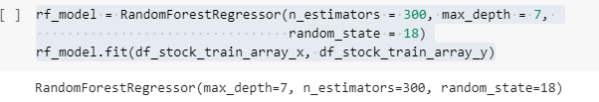
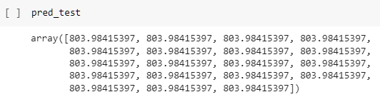
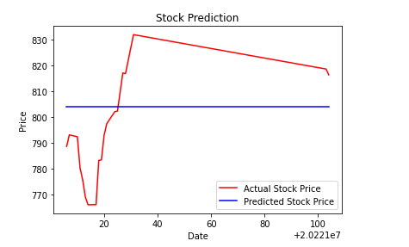
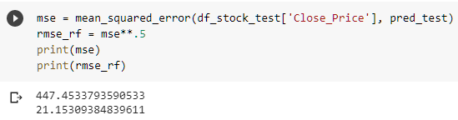
Random Forest Regressor

Slide 16
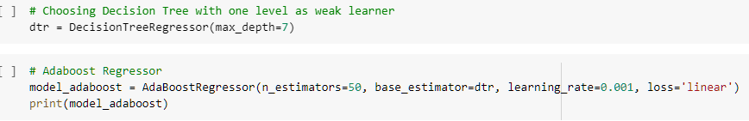
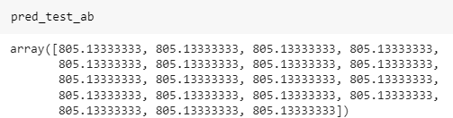
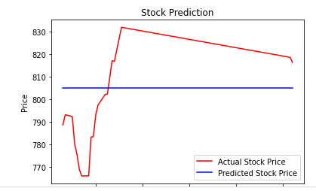
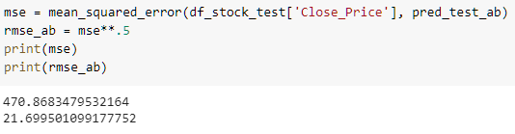
Adaboost Regressor

Slide 17
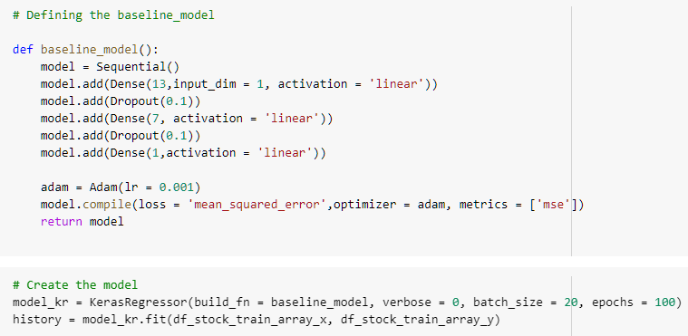
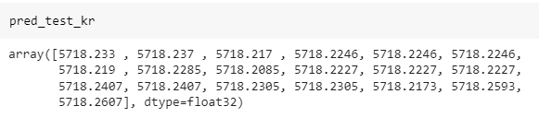
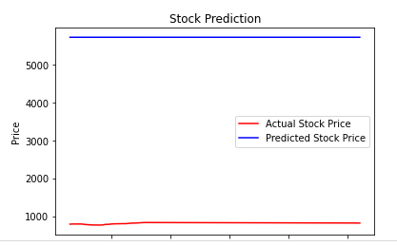
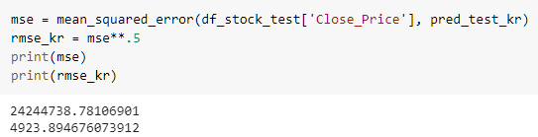
Keras Regressor (Neural Networks)

Slide 18
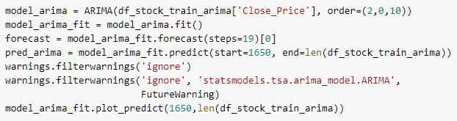
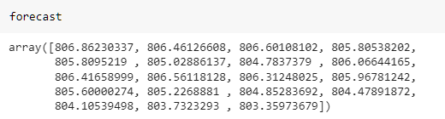
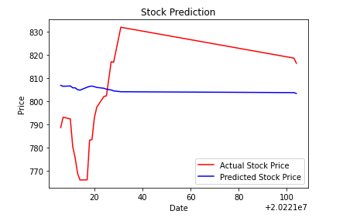
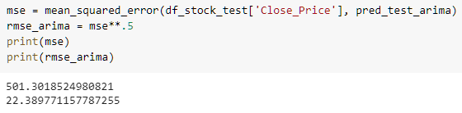
ARIMA (Auto Regression Integrated Moving Average)

Slide 19
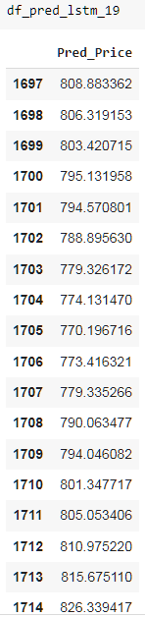
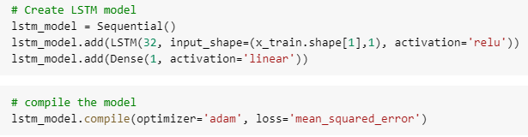
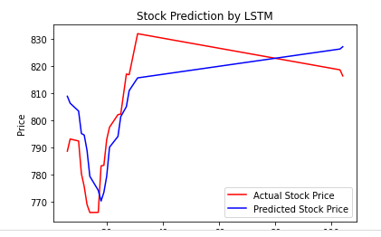
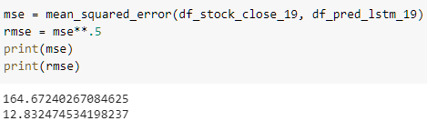
LSTM (Long Short Term Memory)

Slide 20
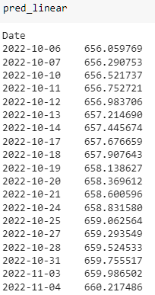

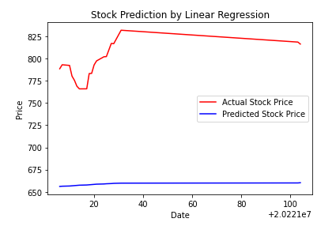
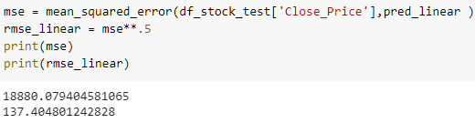
Linear Regression Forecasting

Slide 21
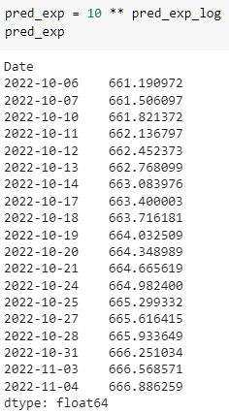


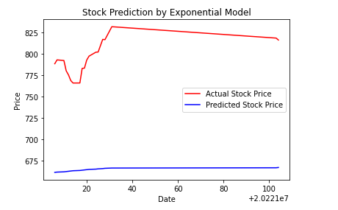
Exponential

Slide 22
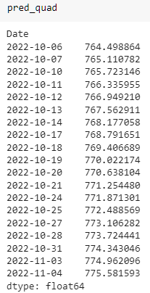

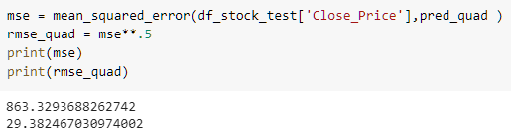
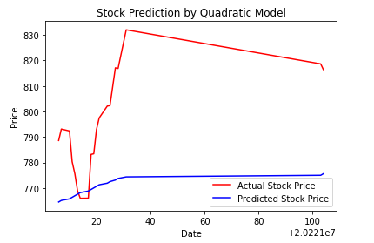
Quadratic

Slide 23
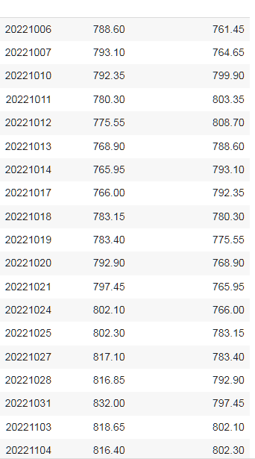

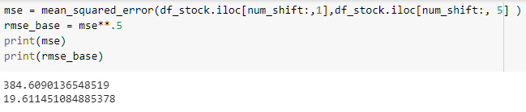
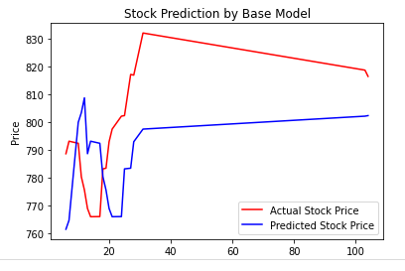
Persistence / Base Model

Slide 24
Evaluation of Models and Conclusion

Slide 25
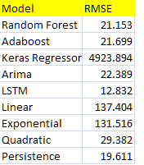
RMSE values comparison
Final Conclusion:
After comparing RMSE values of various models and Predicted values variation in charts, we can conclude that LSTM and Persistence/Base models are best prediction models for this data.

Slide 26
A few more Prediction Models...

Slide 27
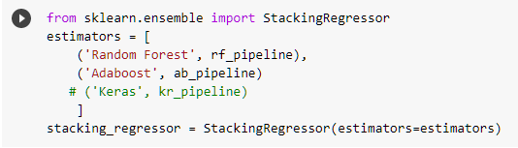
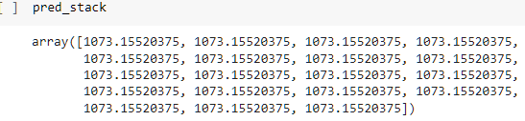
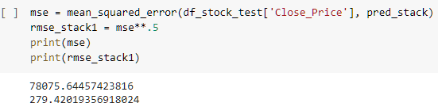
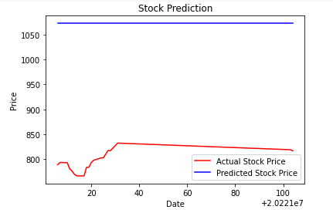
Pipeline Model-1

Slide 28
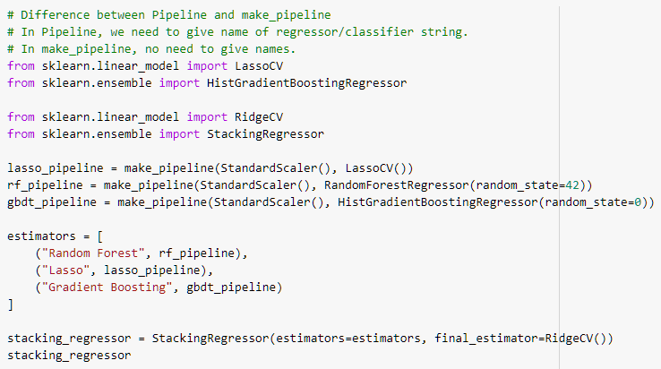
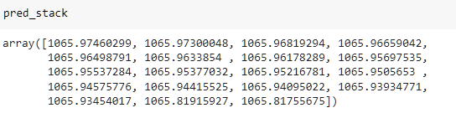
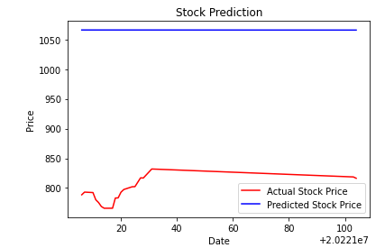
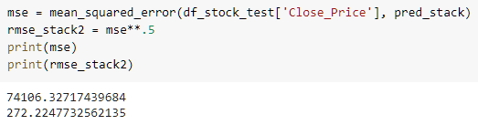
Pipeline Model-2

Slide 29




Smoothed Exponential Moving Average (SEMA)

Slide 30
Final Evaluation of Models and Conclusion

Slide 31

RMSE values comparison
Final Conclusion:
After comparing RMSE values of various models and Predicted values variation in charts, we can conclude that LSTM , ARIMA, Persistence/Base and SEMA models are best prediction models for this data.

Slide 32
Deployment

Slide 33

Input Screen

Slide 34

Smoothed Exponential Moving Average Output Screen (SEMA) – Part1

Slide 35

Smoothed Exponential Moving Average Output Screen (SEMA) – Part2

Slide 36

Autoregressive Integrated Moving Average (ARIMA) – Part1

Slide 37

Autoregressive Integrated Moving Average (ARIMA) – Part2

